Slide 1
ENSEMBLE TRANSFER LEARNING FOR MULTI-STAGE ALZHEIMERS’S DISEASE CLASSIFICATION
GUIDE - Mr.N.S.Sudhakar Reddy(Assistant Professor)
Team Members:
1. Faizuddhin Mohammed (21501A05B4)
2. Kella Pavan Kumar (21501A0584)
3. Nelakuditi Nitin Chowdary (21501A05C6)
4. Kalapala Nirmal (21501A0571)

Slide 2

CONTENTS
Abstract
Introduction
Problem Statement
Objective
Literature Survey
Input Dataset
Requirements
Methodology
Results
Performance Evaluation
Conclusion & Future Scope

Slide 3

ABSTRACT
Alzheimer's disease (AD) is a neurodegenerative disorder requiring early diagnosis for effective treatment.
Traditional machine learning models underperform due to limited data, while deep learning models like CNNs offer better accuracy.
Our proposal introduces an ensemble model combining InceptionV3, Xception, and ResNet50, enhanced with transfer learning and SMOTE, for diagnosing AD using MRI images. .
This ensemble is evaluated against individual models—InceptionV3, Xception, and ResNet50—across four AD stages: Non Demented, very Mild Demented, Mild Demented , Moderate Demented.

Slide 4
INTRODUCTION
Overview: Alzheimer's disease (AD) is a chronic neurodegenerative disorder causing cognitive and behavioral decline, common in aging populations.
Epidemiology: Incidence rises with age (2% at 65, 35% at 85+); 5.8M U.S. cases in 2020 projected to reach 13.8M by 2050.
Stages: Four stages—Non Demented, very Mild Demented, Mild Demented , Moderate Demented. Early detection is crucial.
Challenges: Manual diagnostics are unreliable; MRI is preferred for non-invasive, accessible diagnosis.
Existing Methods: Deep learning models like CNNs improve detection but struggle with class imbalance, reducing accuracy.

Slide 5
PROBLEM STATEMENT
Many architectures have been proposed for AD detection and medical image classification, but they lack a combination of transfer learning, class imbalance techniques in AD classification.
The collected datasets are imbalanced, necessitating resampling techniques like SMOTE to address class imbalance.
Our Project is expected to explore four stages of AD .
It is anticipated that the experimental results, evaluated using four performance metrics, will yield promising outcomes.

Slide 6
OBJECTIVE
The objective of this project is to develop an effective Alzheimer’s Disease (AD) classification model using transfer learning techniques.
The project aims to address the class imbalance issue in AD datasets by applying SMOTE and to explore the classification of four stages of AD.
The goal is to demonstrate the efficacy of the model through high accuracy and robust performance, evaluated using multiple performance metrics.

Slide 7
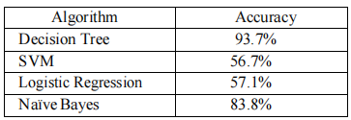
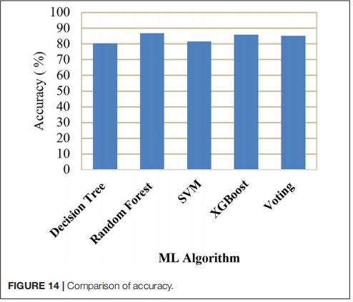
LITERATURE SURVEY
Paper & Author | Approach | Result
Title: Alzheimer's Disease Detection Using Machine Learning | Authors: S. Harika and others | Publisher: IJRASET. | Used OASIS dataset (373 subjects, aged 60-96) Applied Decision Tree(high accuracy), SVM, Naïve Bayes, and Logistic Regression in MATLAB.
Title: Early-Stage Alzheimer’s Prediction Using ML Models | Authors: C. Kavitha and others. | Institutions: Sathyabama Institute, India; Al-Nahrain University, Iraq | Evaluated Decision Tree, SVM, Random Forest, XGBoost, and Voting using 5-fold cross-validation and key metrics. Addressed overfitting and tuned parameters with confusion matrix-based evaluations.

Slide 8
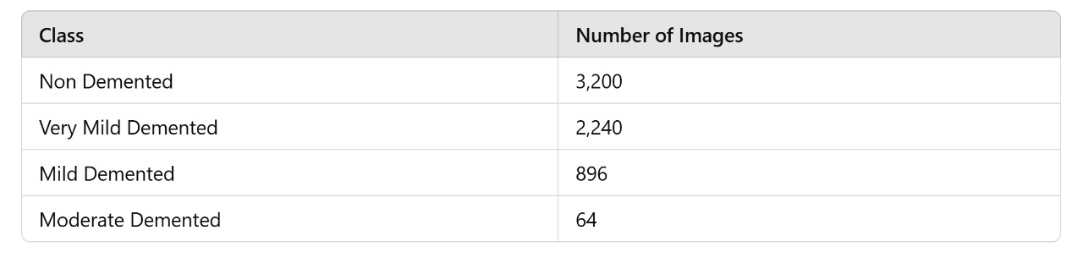
INPUT DATASET
The project utilizes a Kaggle-sourced dataset containing anonymized MRI scan images of patients along with corresponding class labels.
The dataset includes images for four stages of Alzheimer's disease (AD):
Non Demented
very Mild Demented
Mild Demented
Moderate Demented.

Slide 9
REQUIREMENTS
Hardware Requirements:
Processor: Intel Core i5 or AMD Ryzen 5 (or higher)
RAM: Minimum 8 GB (or higher)
Software Requirements:
Operating System: Windows 10/11, Ubuntu 20.04 (or higher), macOS
IDE/Editor: Jupyter Notebook or VS Code
Flask/Django for web interface development

Slide 10
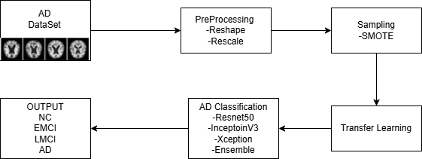
METHODOLOGY DIAGRAM:

Slide 11
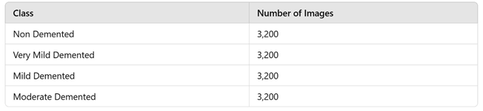
METHODOLOGY
The project sourced MRI scans from a Kaggle dataset covering 4 AD stages: Non Demented, very Mild Demented, Mild Demented , Moderate Demented. These images were preprocessed by normalizing pixel values to a 0-1 range and resizing them to 224x224 for model compatibility.
Data augmentation with random flips and rotations was applied to enhance variety and improve model robustness.
To address class imbalance, SMOTE was used, synthetically oversampling minority classes.

Slide 12
METHODOLOGY
Three pre-trained models—InceptionV3, Xception, and ResNet50—were selected, leveraging ImageNet weights for initial feature extraction.
Transfer learning involved freezing early layers of each model and fine-tuning the top layers on AD-specific MRI data. Training ran for 50 epochs using the Adam optimizer with a batch size of 32 for stable convergence.
An ensemble approach combined outputs from all three models, using majority voting to determine final predictions. The dataset was split into 60% for training and 20% each for validation and testing to ensure robust assessment. Performance was evaluated using Accuracy, Precision, Recall, and F1-Score for a comprehensive analysis.

Slide 13
Results
Individual results showed InceptionV3 at 87% and Xception at 93%, while ResNet50 reached 96% on the test set. Applying SMOTE significantly boosted detection of the classes, improving recall by approximately 15% for this minority group.
A comparison revealed the ensemble outperformed single models by 1-2.5% margin, demonstrating its strength in consistency. Detailed metrics were generated for further analysis, providing a clear picture of performance across stages of AD classifications.
The ensemble model was tested against individual models, achieving an impressive ~98% accuracy across all four AD stages.

Slide 14
Performance Evaluation
Performance evaluation showed the ensemble achieving ~98% accuracy overall, with top results for AD stages due to their larger sample sizes.
Recall saw notable improvement with SMOTE, enhancing detection rates for early stages. The F1-Score, averaging ~90% across classes, reflected a strong balance between precision and recall. Compared to the literature’s Decision Tree at 93.7%, our model generalized better on imbalanced data, proving its robustness for real-world use.

Slide 15
Conclusion & Future Scope
This project successfully built an ensemble model for AD classification, integrating InceptionV3, Xception, and ResNet50 with transfer learning.
It achieved ~98% accuracy and effectively tackled class imbalance using SMOTE, ensuring reliable results across all stages. The model supports early detection of AD, offering potential for timely interventions that improve patient outcomes.
Future work could expand the dataset with more MRI scans and deploy the model as a web-based diagnostic tool for broader access. By outperforming traditional machine learning approaches, this ensemble method demonstrates a powerful step forward in Alzheimer’s research.

Slide 16

Team Member Details

